Slide 1
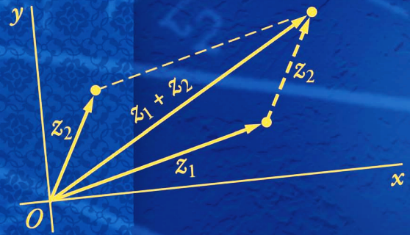
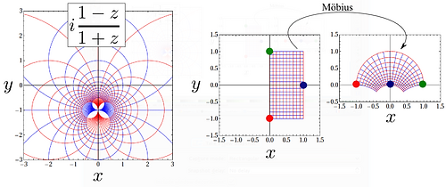
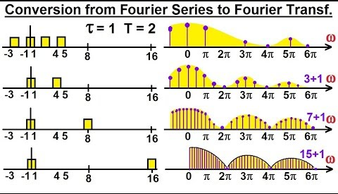
Complex Variables & Transforms (CVT)
MATH- 232
Instructor:Mr.Saeed Afzal

Slide 2

What is CVT??
The course of complex variables and transform (CVT) is a vital course in the EE department where the understanding of several advanced courses at both UG and PG level entirely depends on the core concepts of CVT. Needless to say research in these disciplines also rely on the understanding of basic concepts of a student in CVT.
This course provides sound knowledge of calculus in the complex domain with a detailed discussion on complex algebra, complex functions, analyticity and contour integration. It also covers Fourier Series, Fourier Integrals and Fourier Transforms. Besides Z-transform is also part of this course.

Slide 3
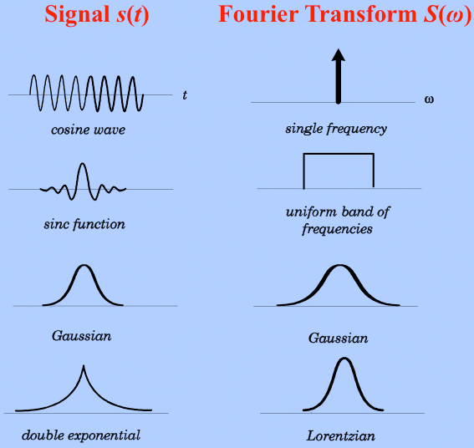
Complex Variables & Transform (CVT)
Fourier transforms are a fundamental part of signal processing in electrical engineering and in order to properly understand, and employ Fourier transforms, one must have a background in complex analysis.
In addition, some of the computation in circuit analysis involves complex numbers and phase shifts can be dealt with in the complex plane.
In the subsequent slides a list of advanced courses is given where CVT is a pre-requisite of all of them.

Slide 4











Complex Variables & Transform (CVT)
Signals and Systems
Non-Electives
Electives
Digital Signal Processing
Digital Image Processing
Communication Systems II
Communication Systems
Mobile Communication Systems
Broadband Technologies

Slide 5





Complex Variables & Transform (CVT)
Signals and Systems
Non-Electives
Electives
Digital Control Systems
Control Systems
Optimal Control
Introduction to Non-linear Control
Although CVT is not a pre-requisite of control systems at SEECS but at MIT and elsewhere it is a pre-requisite. Since control systems further divides into linear and nonlinear control systems therefore, we may also pick up applications from these branches.

Slide 6










Complex Variables & Transform (CVT)
Linear Circuit Analysis
Non-Electives
Electives
Electrical Network Analysis
Opto-Electronics
Power System Analysis & Design
Electrical Machines
Electric Device
Microwave Engineering
Electromagnetic Field Theory
Transmission Lines & Waveguides

Slide 7




Complex Variables & Transform (CVT)
Main Topics
Complex Variables
Transforms
Complex Functions
Fourier Series
Limits, Derivatives in Complex Domain
Fourier Transforms
Contour Integration
Z-transform
Laplace Equations
Applications

Slide 8
Complex Variables & Transform (CVT)
Text Books
Advanced Engineering Mathematics (9th Edition) by Ervin Kreyszig
Applied Complex Variables for Scientists and Engineers by Yue Kuen Kwok
A first course in complex analysis with applications by Dennis G. Zill
Reference Books
Real and Complex Analysis by Walter Rudin.
Complex Variables & Applications by James Ward Brown, Ruel V.Churchill.
Advanced Engineering Mathematics by Peter V. O’Neil.
Advanced Modern Engineering Mathematics by Glyn James.

Slide 9

Course Objectives:
First objective of the course is that on the successful completion students should develop understanding of complex functions, analyticity and contour integration. The applications will be covered from potential theory of harmonic functions.
The other objective is to learn solution techniques of Fourier series and Fourier transform approach is dealt rigorously.

Slide 10
Course Learning Outcomes (CLOs)
After successful completion of this course, the students will be able to:
CLO-1: Describe Complex functions, derivatives, contour integrals. (PLO-2)
CLO-2: Represent a given function in terms of Fourier series and Fourier integrals. (PLO-1)
CLO-3: Evaluate Fourier and Z-transforms of a given function. (PLO-1)

Slide 11

Marks Distribution

Slide 12
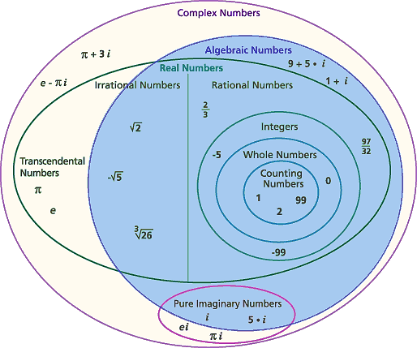
Complex Numbers

Slide 13
Complex Numbers
Complex Numbers show up all over the place in engineering, computer science and as well as scientific computing. Examples include:
Fast Fourier Transforms for Signal Processing,
Circuit Simulation (Complex Numbers are very common in Electrical Engineering),
Fractals which get used in Graphics and various other fields.
Closely related to the electrical engineering, example is the use of complex numbers in signal processing, which has applications to:
telecommunications (cellular phone),
radar (which assists the navigation of airplanes),

Slide 14

How is complex analysis used in
electrical engineering?
Almost everything in EE involves complex analysis at some level:
Basic circuit analysis using Laplace transforms and phasors.
The concept of complex impedance.
Conformal maps like the Smith Chart.
Digital modulation and analysis of its performance etc.
Complex analysis is used in any kind of circuit design including power systems and electronics and is also completely fundamental to signal processing and communications

Slide 15
What is a complex number?

Slide 16
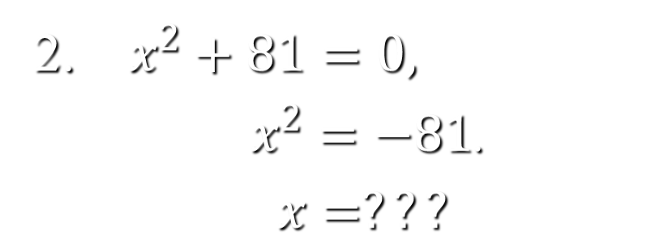
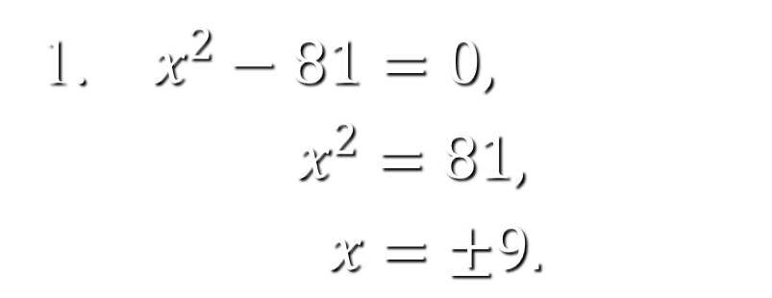
To see a complex number we have to first see where it shows up
Consider the following:
1. $x^{2}−81=0,$
$x^{2}=81,$
$x=±9.$
How to deal with this?
2. $x^{2}+81=0,$
$x^{2}=−81$.
$x=???$

Slide 17
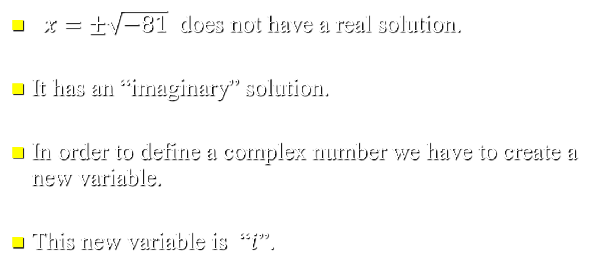
No solution????
$x=±\sqrt{−81}$ does not have a real solution.
It has an “imaginary” solution.
In order to define a complex number we have to create a new variable.
This new variable is “$i$”.

Slide 18
What is a complex number?
It is a tool to solve an equation.

Slide 19
What is a complex number?
It is a tool to solve an equation.
It has been used to solve equations for the last 200 years or so.

Slide 20
What is a complex number?
It is a tool to solve an equation.
It has been used to solve equations for the last 200 years or so.
It is defined to be i such that ;

Slide 21

What is a complex number?
It is a tool to solve an equation.
It has been used to solve equations for the last 200 years or so.
It is defined to be i such that ;
Or in other words;

Slide 22
Complex
i is an imaginary number

Slide 23
Complex
i is an imaginary number
Or a complex number

Slide 24
Complex
i is an imaginary number
Or a complex number
Or an unreal number

Slide 25
Complex?
i is an imaginary number
Or a complex number
Or an unreal number
The terms are inter-changeable
unreal
complex
imaginary

Slide 26
Some observations
In the beginning there were counting numbers
1
2

Slide 27
Some observations
In the beginning there were counting numbers
And then we needed integers
1
-1
2
-3

Slide 28
Some observations
In the beginning there were counting numbers
And then we needed integers
And rationals
1
0.41
-1
2
-3

Slide 29
Some observations
In the beginning there were counting numbers
And then we needed integers
And rationals
And irrationals
1
0.41
-1
2
-3

Slide 30
Some observations
In the beginning there were counting numbers
And then we needed integers
And rationals
And irrationals
And reals
1
0.41
-1
2
-3

Slide 31
So where do unreals fit in ?
We have always used them. 6 is not just 6 it is 6 + 0i. Complex numbers incorporate all numbers.
2i
3 + 4i
1
-1
2
-3

Slide 32
A number such as 3i is a purely imaginary number

Slide 33
A number such as 3i is a purely imaginary number
A number such as 6 is a purely real number

Slide 34
A number such as 3i is a purely imaginary number
A number such as 6 is a purely real number
6 + 3i is a complex number

Slide 35
A number such as 3i is a purely imaginary number
A number such as 6 is a purely real number
6 + 3i is a complex number
x + iy is the general form of a complex number

Slide 36
A number such as 3i is a purely imaginary number
A number such as 6 is a purely real number
6 + 3i is a complex number
x + iy is the general form of a complex number
If x + iy = 6 – 4i then x = 6 and y = – 4

Slide 37
A number such as 3i is a purely imaginary number
A number such as 6 is a purely real number
6 + 3i is a complex number
x + iy is the general form of a complex number
If x + iy = 6 – 4i then x = 6 and y = – 4
The ‘real part’ of 6 – 4i is 6

Slide 38
Complex Numbers
Algebra of complex numbers
Solution of quadratic equations
Powers of
Complex conjugate
Argand diagram
Polar form (Euler's Formula)
De Moivre’s Theorem

Slide 39
Worked Examples
Simplify

Slide 40
Worked Examples
Simplify

Slide 41
Worked Examples
Simplify
Evaluate

Slide 42
Worked Examples
Simplify
Evaluate

Slide 43
Worked Examples
3. Simplify

Slide 44
Worked Examples
3. Simplify

Slide 45
Worked Examples
3. Simplify
4. Simplify

Slide 46
Worked Examples
3. Simplify
4. Simplify

Slide 47
Worked Examples
3. Simplify
4. Simplify
5. Simplify

Slide 48
Addition Subtraction Multiplication
3. Simplify
4. Simplify
5. Simplify

Slide 49
Division
6. Simplify

Slide 50
Division
6. Simplify
The trick is to make the denominator real:

Slide 51
Division
6. Simplify
The trick is to make the denominator real:

Slide 52
7. Simplify

Slide 53
Solving Quadratic Functions
8. Solve

Slide 54
Book: Advanced Engineering Mathematics (9th Edition) by Ervin Kreyszig
Chapter: 13
Sections: 13.1 , 13.2
Book: A First Course in Complex Analysis with Applications by Dennis G. Zill and Patrick D. Shanahan.
Chapter: 1
Sections: 1.1, 1.2, 1.3

Slide 55
Lets try these problems.

Slide 56
Solving Quadratic Equations
Solve:

Slide 60
Complex Conjugate
When then its complex conjugate is denoted by:
Note:
This is useful when we wish to carry out a division.

Slide 61
Developing useful rules

Slide 62
Developing useful rules

Slide 63
Developing useful rules

Slide 64
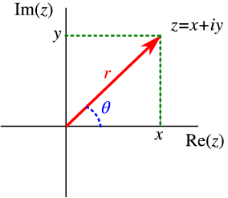
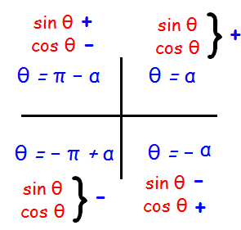
Argand Diagrams
&
Polar Form
Argand diagrams are used to visualise complex numbers.
It also shows how to calculate the modulus and argument of a complex number, their role in the polar form of a complex number and how to convert between Cartesian and polar forms.

Slide 65
Argand Diagram
y
2 + 3i
3
2
1
x
1
2
3

Slide 66
Argand Diagram
y
2 + 3i
3
2
1
x
1
2
3
We can represent complex numbers as a point.

Slide 67
Argand Diagram
y
3
2
1
x
1
2
3

Slide 68

Argand Diagram
y
3
2
1
$$A$$
x
O
1
2
3
We can represent complex numbers as a vector.

Slide 69


Argand Diagram
y
3
$$B$$
2
1
$$A$$
x
O
1
2
3

Slide 70

Argand Diagram
y
$$C$$
3
$$B$$
2
1
$$A$$
x
O
1
2
3

Slide 71

Argand Diagram
Addition of Complex numbers
y
$$C$$
3
$$B$$
2
1
$$A$$
x
O
1
2
3

Slide 72

Argand Diagram
y
$$C$$
3
$$B$$
2
1
$$A$$
x
O
1
2
3

Slide 73


Argand Diagram
y
$$C$$
3
$$B$$
2
1
$$A$$
x
O
1
2
3

Slide 74


Argand Diagram
y
$$C$$
3
$$B$$
2
1
$$A$$
x
O
1
2
3

Slide 75
Argand Diagram
y
$$C$$
3
$$B$$
2
1
$$A$$
x
O
1
2
3

Slide 76
Argand Diagram
Subtraction of Complex numbers
y
$$C$$
3
$$B$$
2
1
$$A$$
x
O
1
2
3

Slide 77

Mod-Arg Form
Modulus
The modulus of a complex number is the
length of the vector OZ
r ² = x² + y²
y
z = x + iy
r = |z|
y
θ
x
x
Argument
The argument of a complex number is the angle the vector OZ makes with the positive real (x) axis. An argument θ of a complex number must satisfy the equation:
O

Slide 78

The modulus and argument of a complex number
An argument $θ$ of a complex number must satisfy the equations $\cos{θ}=x/|z|$ and $\sin{θ}=y/\left|z\right|.$ An argument of a complex number $z$ is not unique because $\sin{θ}$ and $\cos{θ}$are $2π−$periodic and any integer multiple of 2π may be added to $θ$ to produce another value of the argument. In other words, if θₒ is an argument of z, then necessarily the angles θₒ ± 2π, θₒ ± 4π,….. are also arguments of z.
A calculator will give only angles satisfying that is, angles in the first and fourth quadrants. We have to choose θ consistent with the quadrant in which z is located; this may require adding or subtracting π to arctan (y/x) when appropriate.

Slide 79
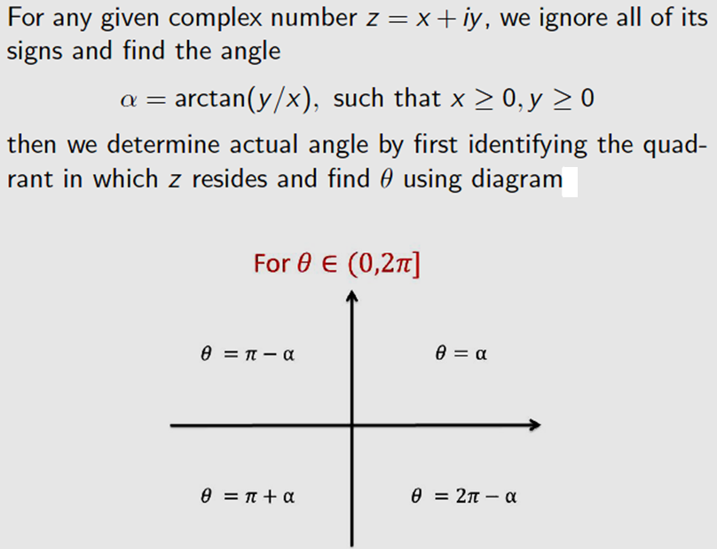
An Easy Way To Determine Argument

Slide 80
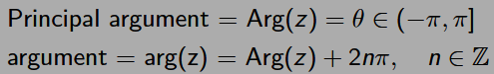
Principal Argument
The symbol arg(z) actually represents a set of values, but the argument θ of a complex number that lies in the interval −π < θ ≤ π is called the principal value of arg(z) or the principal argument of z.
The principal argument of z is unique and is represented by the symbol Arg(z), that is,
−π < Arg(z) ≤ π.
Relationship between the argument of the complex number z, denoted by arg(z), and the principal argument of z, denoted by Arg(z) is defined as:

Slide 81
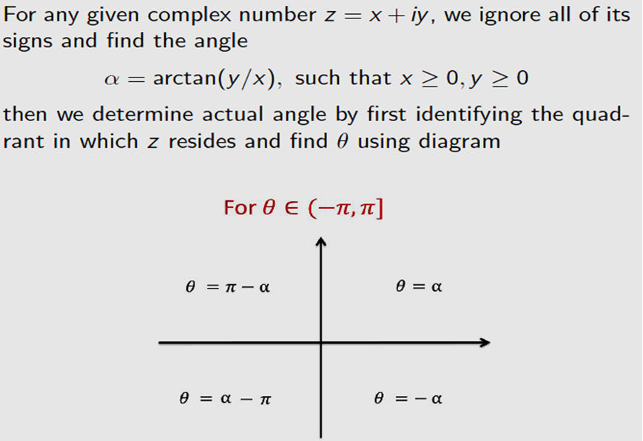
An Easy Way To Determine Principal Argument

Slide 82
An alternate way to determine principal argument
Complex numbers either on the real axis or in the upper half of the complex plane have a positive argument measured anti-clockwise from the real axis.
Complex numbers in the lower half of the complex plane have a negative argument measured clockwise from the real axis.
This can be confusing and the table below is designed for help. It is a very good idea to sketch complex number before trying to calculate its argument.

Slide 83
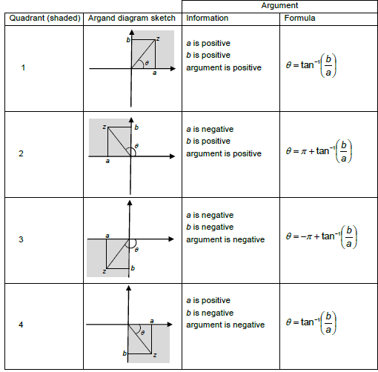

Slide 84
Note:
The real axis is part of quadrants 1 and 2 (not quadrants 3 and 4). Given this:
Positive real numbers are in quadrant 1 and have an argument of 0.
Negative real numbers are in quadrant 2 and have an argument of π.

Slide 85
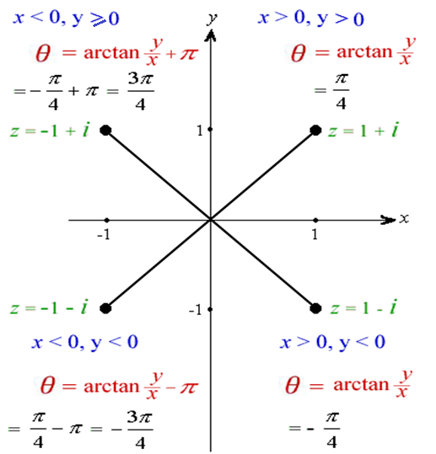
Example

Slide 86
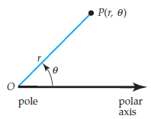
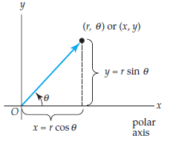
Polar Form
Polar coordinates in the complex plane

Slide 87
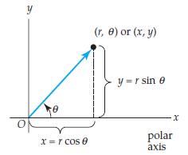
Polar Form
Suppose that a polar coordinate system is superimposed on the complex plane with the polar axis coinciding with the positive x-axis and the pole O at the origin.
Then x, y, r and θ are related by x = r cos θ, y = r sin θ.
These equations enable us to express a nonzero complex number z = x + iy as:
z = r (cos θ + i sin θ) = r cis θ. (1)
We say that (1) is the polar form or polar representation of the complex number z.

Slide 88
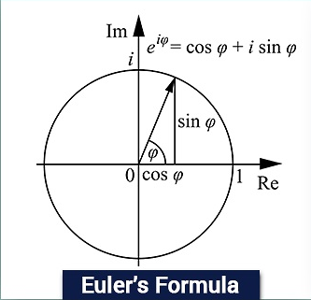
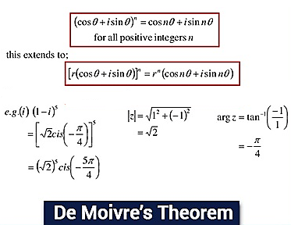
Euler’s formula and De Moivre’s Theorem

Slide 89
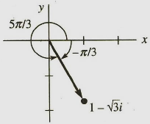
Example

Slide 90
Example

Slide 91
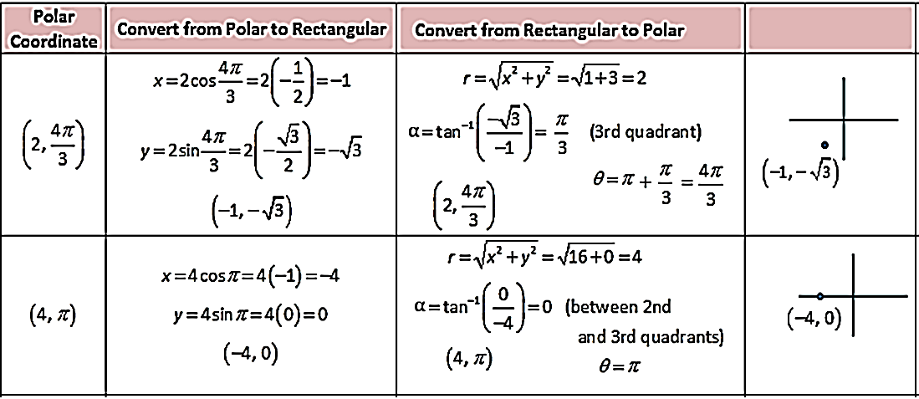
Conversion between the forms
Polar to Rectangular
x = r cos θ, y = r sin θ
Rectangular to Polar

Slide 92
Euler’s formula and De Moivre’s Theorem

Slide 93
Euler’s Formula & Exponential form
Every complex number can be expressed in a polar form which, however, depends on the use of Euler’s formula
Thus, we can rewrite polar form, z = r (cos θ + i sin θ) = r cis θ, of a complex number z = x + iy as:
Eq. (2) is reffered to as the exponential form of a complex number z. The angle θ lies conventionally in the range −π < θ ≤ π, but, since rotation by θ is the same as rotation by θ$+\text{2}\text{nπ}$, where $n$ is any integer, so,
Note: Engineers prefer to use exponential form because this form is easy to manipulate.

Slide 94
Multiplication and Division in Polar Form
The polar form of a complex number is especially convenient when multiplying or dividing two complex numbers. Suppose
where θ1 and θ2 are any arguments of z1 and z2, respectively. Then
Similarly, for

Slide 95
Multiplication and Division in Exponential Form
Multiplication and division in exponential form are particularly simple. The product of is given by:
The relations follow immediately.
Division is equally simple in polar form; the quotient of is given by
and the relations follow immediately.

Slide 96
Example

Slide 97
Now consider.
This leads to the pattern:

Slide 98
De Moivre’s Theorem
De Moivre's theorem, named after the French mathematician Abraham de Moivre, is used the find the roots of a complex number for any power n, given that n is an integer.
De Moivre's theorem can be derived from Euler's equation, and is important because it connects trigonometry to complex numbers.
For any complex number z and any integer n, the following is true:

Slide 99
a) Given find

Slide 100
Applications of De Moivre’s Theorem
To express cos nθ and sin nθ as finite sums of trignometric functions of θ, where n is a positive integer.
To express powers of cos θ (or sin nθ) in a series of cosines (or sines) of multiples θ.
To find nth roots of a complex number.

Slide 101
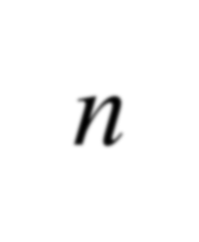
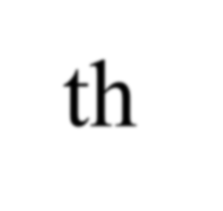

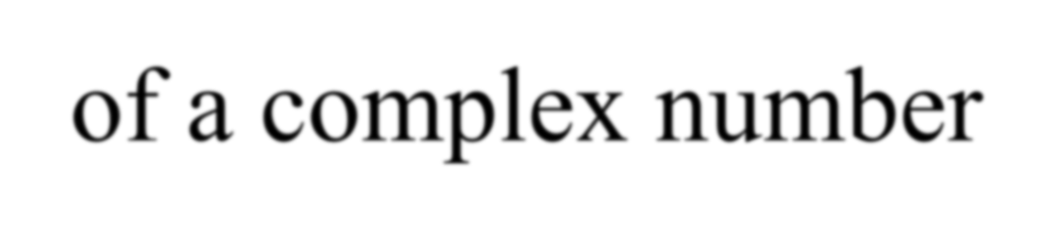

nth roots of a complex number
Suppose r(cosθ+ i sinθ) and ω= ρ(cosϕ+ i sinϕ) are polar forms
of the complex numbers z and ω respectively. Then, the equation ω^{n}= z,
becomes
ρ ^{n} (cos nϕ+ i sin nϕ) = r(cosθ+ i sinθ).
(1)
From (1), we can conclude that
_{ρ} n
(2)
= r,
and
cos nϕ + i sin nϕ = cosθ + i sinθ.
(3)
From (2), we define ρ = r^{1/ n} , to be the unique positive nth root of the positive real number r. From (3), the definition of equality of two complex numbers implies that
cos nϕ = cosθ and sin nϕ = sinθ.

Slide 102
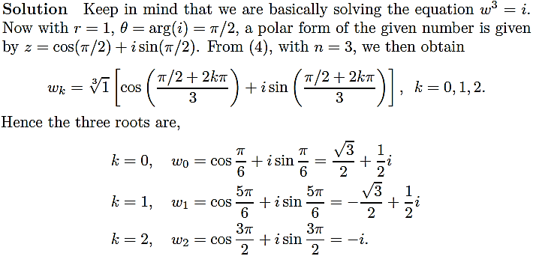

Example
Find the cube roots of $z =i$.

Slide 103
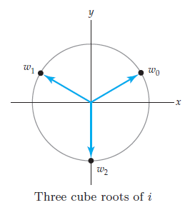
Example
Note that, since Arg(z) = π/2, we see that
ω ₀ ≈ 0.8660+ 0.5i,
is the principal cubic root of $z = i$.
As shown in figure, the three roots lie on a circle centered at the origin of radius r ≈ 1 and are spaced at equal angular intervals of 2π/3 radians, beginning with the root whose argument is π/6.

Slide 104
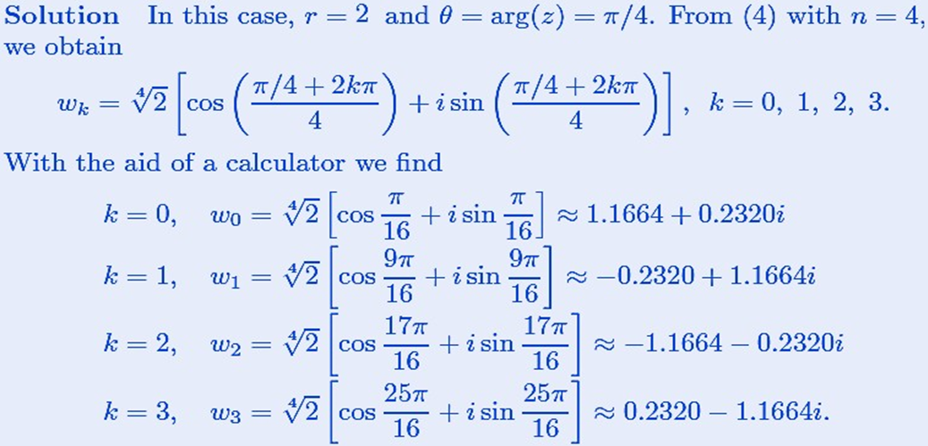

Example
Find the four fourth roots of $z = \sqrt{2}(1+i)$.

Slide 105
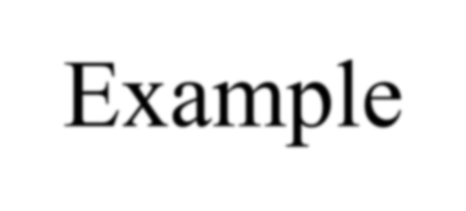
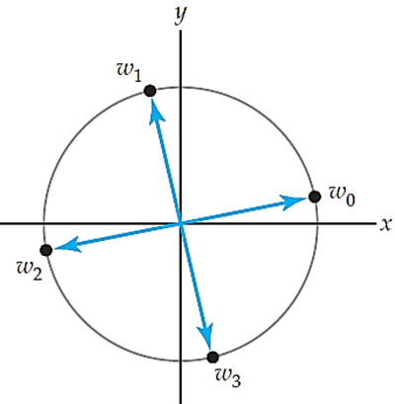

Example
Note that, since Arg(z) = π/4, we see that
ω₀ ≈ 1.1664
+ 0.2320i,
is the principal fourth root of $z = \sqrt{2}(1+i)$. As shown in figure, the four roots lie on a circle centered at the origin of radius r ≈ 1.19 and are spaced at equal angular intervals of 2π/4 = π/2 radians, beginning with the root whose argument is π/16.

Slide 106
Complex Magic
Every complex number can be transformed into polar form. For z = i , we
obtain
_{i = e}iπ/2 .
Thus, in reality i correspond to rotation by 90 degrees. This is the reason why the imaginary part is always sketched on the y−axis as it is at 90º to x−axis.
Suppose we have two complex numbers in exponential form
z₁ = r₁e
iθ
and
1
iθ
z = r e ,
then their product is defined as:
2 2
2
_{e}i (θ₁ +θ₂ ) .
rotation
z z = r r
×
1 2
1 2
re-scaling
Therefore we conclude that a complex product encodes an information of two real physical operations re-scaling and rotation. We can think on similar lines about other complex operations e.g., addition, division, complex conjugation.

Slide 107
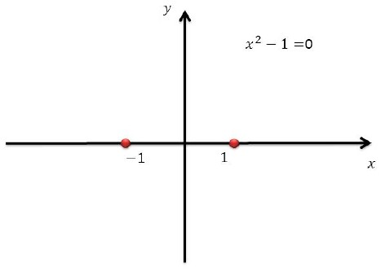
Complex Magic
Let us explore the complex domain in more detail. Consider a real quadratic equation
x ² − 1 = 0.
We know that the solutions of this equation are x = ±1, which are two points on the real line.

Slide 108
Complex Magic
Now consider the complex equation
z ² − 1 = 0.
How many solution does this complex equation has?
Of course two z = ±1, two points on the complex plane. If the answers are same then we might believe that both equations are same !!!. It is certainly not true.
The beauty of second equation can only be seen if we substitute z = x + iy , into the
equation, i.e,
(x + iy )² − 1 = 0
x ² − y ² + 2ixy − 1 = 0
x ² − y ² − 1 + i 2xy = 0 + i 0 which gives two equations
x ² − y ² = 1, 2xy = 0,
The first is an equation of a hyperbola and the other is an equation of x − or y −axis.

Slide 109
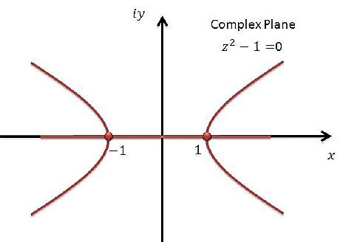
Complex Magic
Therefore we can conclude that the two solutions z = ±1, are basically two points on the intersection of hyperbolas and x − axis.

Slide 110




Some important facts about complex numbers
1. Space of all complex numbers is a vector space.
1 ₌ z
_{z z} 2
2.
,
where
z = x + iy.
3. (triangular inequality)
z₁ + z₂ ≤ z₁ + z₂ .
4. An n−th degree complex polynomial equation has n complex roots. On the other hand an n−th degree real polynomial equation may or may not have n real roots.
_{e}z _{= e}x+iy
5. If z = x + iy, we define = e^{x} (cos y + i sin y).
6. If $α$ is real and positive, we define: $α^{z}=e^{z\ln{α}}.$

Slide 111
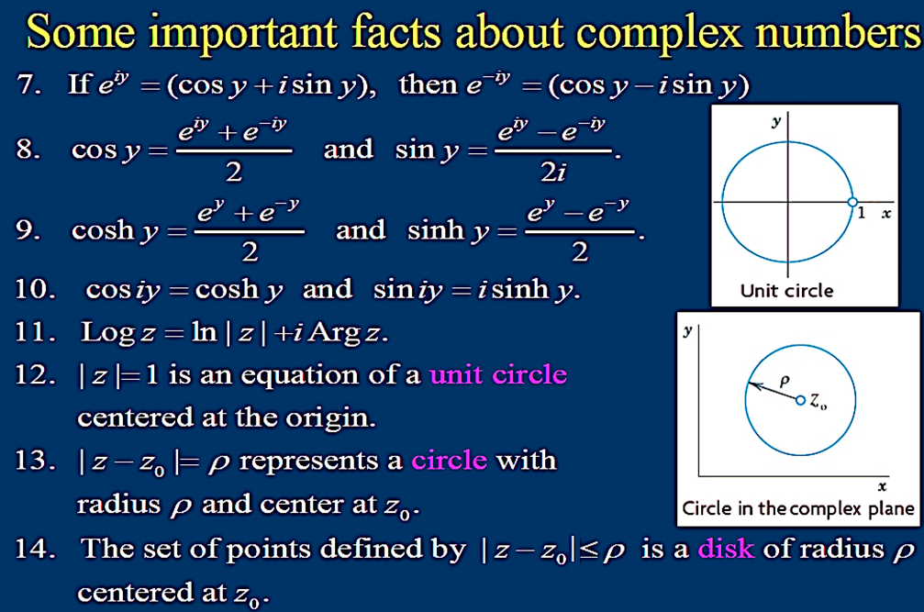

Slide 112
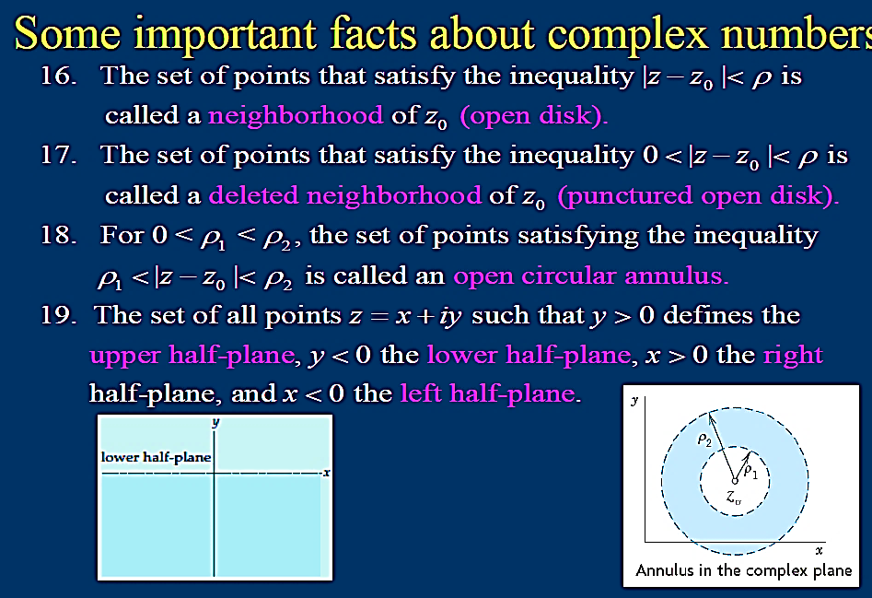

Slide 113
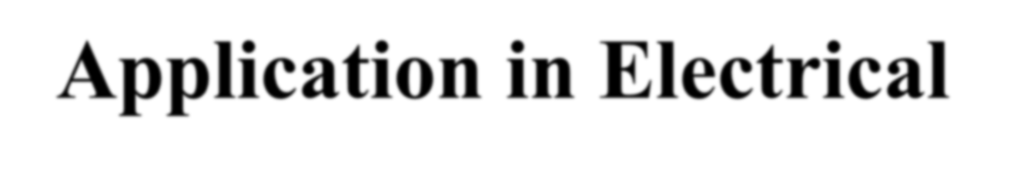
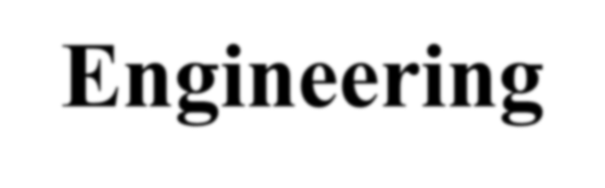

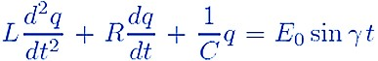
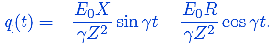
Application in Electrical Engineering
In applying mathematics to physical situations, engineers and mathematicians often approach the same problem in completely different ways. For example, consider the problem of finding the steady-state current i(t) in an LRC-series circuit in which the charge q(t) on the capacitor for time t > 0 is described by the differential equation:
(1)
where the positive constants L, R, and C are, in turn, the inductance, resistance, and capacitance. Now to find the steady-state current i(t), we first find the steady-state charge on the capacitor by finding a particular solution q(t) of (1). By using method of undetermined coefficients and assuming a particular solution of the form q (t) = Asin γt + B cos γt, we can find the steady-state charge in the circuit as:

Slide 114
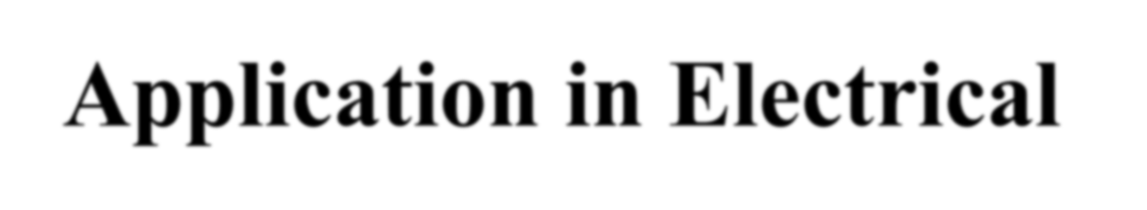
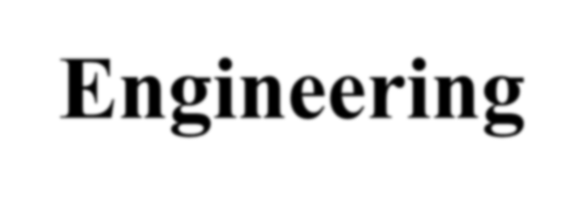

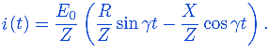
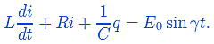
Application in Electrical Engineering
From this solution and i (t) = q´(t) we obtain the steady-state current:
(2)
Electrical engineers often solve circuit problems such as this by using complex analysis. First of all, to avoid confusion with the current i, an electrical engineer will denote the imaginary unit i by the symbol j; in other words, j² = −1. Since current i is related to charge q by i = dq/dt, the differential equation (1) is the same as:
(3)
Now in view of Euler’s formula, if θ is replaced by the symbol γ, then the
impressed voltage E ̥ sin γt is the same as Im(E e ^{jγ t} ). Because of this last form.
0
the method of undetermined coefficients suggests that we try a solution of (3) in
the form of a constant multiple of a complex exponential, that is, i(t) = Im( Ae ^{jγ t} ).

Slide 115
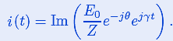
Application in Electrical Engineering
We substitute this last expression into equation (3), assume that the complex exponential satisfies the “usual” differentiation rules, use the fact that charge q is an antiderivative of the current i, and equate coefficients of e ^{jγ t} . After few calculations, we obtain the steady-state current as:
(4)
We can easily verify that the expression in (2) is the same as that given in (4).

Slide 116

Practice Questions
Find the three cube roots of $z = −1+i$.
Find the squares of all the cube roots of $− i$.
Find the four fourth roots of $z = −2\sqrt{3}+2i$.
Find the squares of all the 5th roots of $\frac{1}{2}+\frac{\sqrt{3}}{2} i$.
Find the six 6th roots of (i) $−1$ and (ii) $1+i$.

